Slide 1



MICROCONTROLLER BASED SYSTEM DESIGN
CSE 3215
Lecture 8

Slide 2
Analog and Digital Signals
signals can be either analog or digital.
An analog signal has infinitely many levels of intensity over a period of time.
As the wave moves from value A to value B, it passes through and includes an infinite number of values along its path.
A digital signal, on the other hand, can have only a limited number of defined values. Although each value can be any number, it is often as simple as 1 and O.

Slide 3
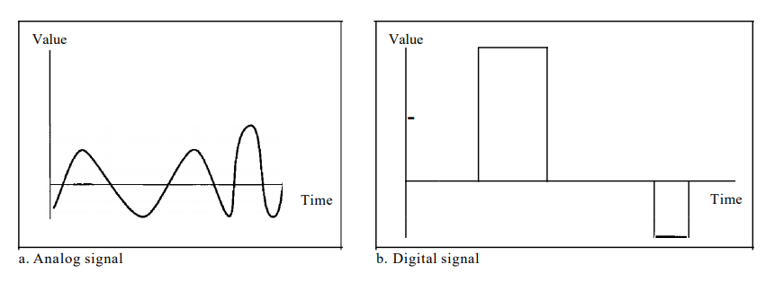
Analog and Digital Signals

Slide 4
Periodic and Nonperiodic Signals
Both analog and digital signals can take one of two forms: periodic or nonperiodic.
A periodic signal completes a pattern within a measurable time frame, called a period, and repeats that pattern over subsequent identical periods.
The completion of one full pattern is called a cycle.
A nonperiodic signal changes without exhibiting a pattern or cycle
that repeats over time.
Both analog and digital signals can be periodic or nonperiodic.

Slide 5
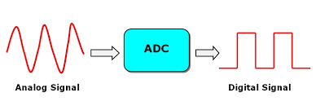
Analog to Digital Converter (ADC)
An analog-to-digital converter is a system that converts an analog signal into a digital signal.
An ADC inputs an analog electrical signal such as voltage or current and outputs a binary number as digital output.

Slide 6
Analog to Digital Converter (ADC)
Resolution of ADC
The resolution of the converter indicates the number of discrete values it can produce over the range of analog values.
The resolution of an A/D converter (ADC) is specified in bits and determines how many distinct output codes (2^{n}) the converter is capable of producing.
For example, an 8-bit ADC produces 2⁸, or 256 output codes.
In other words, resolution is the smallest voltage increment corresponding to a 1 LSB change.

Slide 7
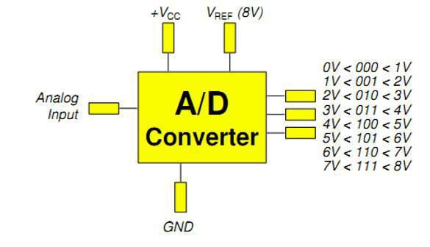
Analog to Digital Converter (ADC)
A 3-bit ADC gives 8 possible output codes.
More bits give better resolution and smaller steps.
A lower reference voltage gives
smaller steps but can be at the
expense of noise.
In the left, we can see an example. If input voltage is 5.5V and reference voltage is 8V then, output will be 101.

Slide 8
Analog to Digital Converter (ADC)
Least Significant Bit (LSB)
Resolution can also be defined electrically, and expressed in volts. The minimum change in voltage required to guarantee a change in the output code level is called the least significant bit (LSB) voltage.
Calculating LSB
For calculating LSB of an ADC, we need to know the Full Scale (FS) range and the resolution of the ADC.
Let, ADC is 8 bits
FS Range = 10 (-5V to +5V) So, Resolution = 2⁸
LSB = 10/2⁸ V = 0.03906 V = 39.06 mV
The Full Scale (FS) Range can also be given in the form of Reference Voltage (Vref).

Slide 9
Analog to Digital Converter (ADC)
Let, ADC is 16 bits
FS Range = 10 (-5V to +5V) Now, calculate LSB

Slide 10
Analog to Digital Converter (ADC)
Solution:
FS Range = 10
16 bit resolution = 2¹⁶= 65,356 bits
Calculation is as follows:
10/65536 = 0.0001525 volts(153 uVolts) So, LSB = 0.0001525 volts

Slide 11
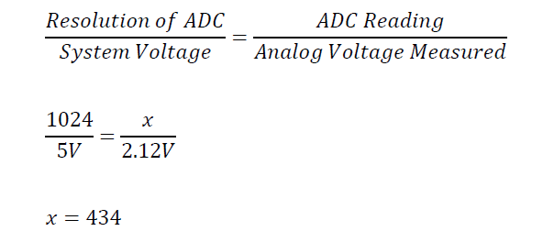
Analog to Digital Converter (ADC)
ADC Reading

Slide 12
Analog to Digital Converter (ADC)
ADC reading = 179 Resolution of ADC = 256 System Voltage = 5V
Analog voltage measured = ?

Slide 13
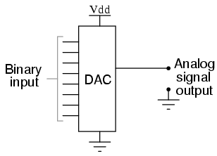
Digital to Analog Converter (DAC)
A Digital to Analog Converter (DAC) is a device that converts a digital signal into an analog signal. A DAC is a type of integrated circuit that is used to convert a parallel binary input from the processor to an analog output current or voltage in proportion to the binary input value.

Slide 14
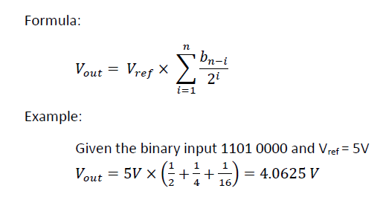
Digital to Analog Converter (DAC)
DAC Calculation

Slide 15

Digital to Analog Converter (DAC)
Resolution of DAC
The smallest analog output change that can occur as a result of changing the LSB of the digital input.
It is also known as step size of DAC converter.
Where, V_{out} = Maximum Output Voltage N = Number of bits

Slide 16
Digital to Analog Converter (DAC)
Resolution of DAC
For example, consider 8 bit DAC which has 0 to 3 V as output voltage range. Now, the step size (or resolution) is equal to 3/2⁸. This gives us 11.72 mV as resolution of DAC. This is the minimum voltage which can be measured using this DAC converter.

Slide 17
Data Acquisition System (DAQ/DAS)
Data acquisition is the process of sampling signals that measure real world physical conditions and converting the resulting samples into digital numeric values that can be manipulated by a computer.
Data acquisition systems, abbreviated by the acronyms DAS or DAQ, typically convert analog waveforms into digital values for processing.

Slide 18
Data Acquisition System (DAQ/DAS)
The components of data acquisition systems include:
Sensors, to convert physical parameters to electrical signals.
Signal conditioning circuitry, to convert sensor signals into a form that can be converted to digital values.
Analog-to-digital converters, to convert conditioned sensor signals to digital values.

Slide 19
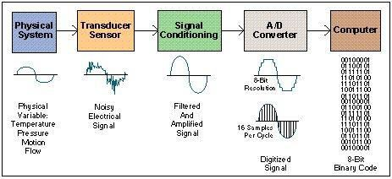
Data Acquisition System (DAQ/DAS)

Slide 20
Data Acquisition System (DAQ/DAS)
Objective
DAS must acquire the necessary data, at correct speed and at correct time.
It must monitor the complete plant operation to maintain on line and safe operations.
It must be able to collect, summarize and store data for diagnosis of operation and record purpose.
It must be flexible and capable of being expanded for future requirements.
It must be able to compute unit performance indices using on-line, real time data.
It must be reliable, easy to operate and must be user friendly.

Slide 21
Data Acquisition System (DAQ/DAS)
Physical System
Physical condition that can be used as input of DAS or which can be represented in digital form are:
Temperature ▪ Displacement
Pressure ▪ Level
Light ▪ Electric Signals
Force ▪ On/OFF switch

Slide 22
Data Acquisition System (DAQ/DAS)
Sensor
The measurement of a physical phenomenon, such as the temperature of a room, the intensity of a light source, or the force applied to an object, begins with a sensor.
A sensor, also called a transducer, converts a physical phenomenon into a measurable electrical signal.
Depending on the type of sensor, its electrical output can be a voltage, current, resistance, or another electrical attribute that varies over time.

Slide 23
Data Acquisition System (DAQ/DAS)
Signal Conditioning
Signals from sensors or the outside world can be noisy or too dangerous to measure directly.
Signal conditioning circuitry manipulates a signal into a form that is suitable for input into an ADC.
This circuitry can include amplification, attenuation, filtering, and isolation.

Slide 24
Data Acquisition System (DAQ/DAS)
Analog-to-Digital Converter (ADC)
Analog signals from sensors must be converted into digital before they are manipulated by digital equipment such as a computer.
An ADC is a chip that provides a digital representation of an analog signal at an instant in time.
In practice, analog signals continuously vary over time and an ADC takes periodic “samples” of the signal at a predefined rate.

Slide 25
Data Acquisition System (DAQ/DAS)
Methodology/Process of Data Acquisition System
DAS begins with the physical property to be measured. Examples of this include temperature, light intensity, gas pressure, fluid flow, force etc.
A sensor, which is a type of transducer converts a physical property into a corresponding electrical signal
Signal conditioning may be necessary if the signal from the transducer is not suitable for the DAQ hardware being used.
After signal conditioning the analog wave output is converted into digital form using A/D converter.
Once digitized, the signal can be encoded to reduce and correct
transmission errors.

Slide 26

THANK YOU

